Slide 1

Project Alpha
Audrey, Kevin, Philip, Wassim

Slide 2
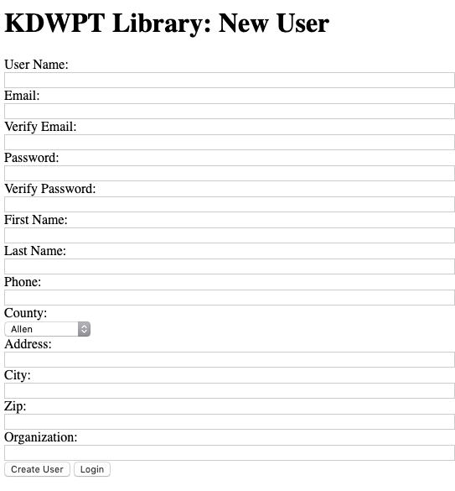
Create Users
Create Users
Login Page Link
Redirect back to Login

Slide 3
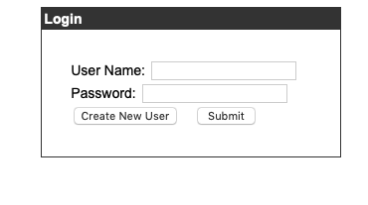
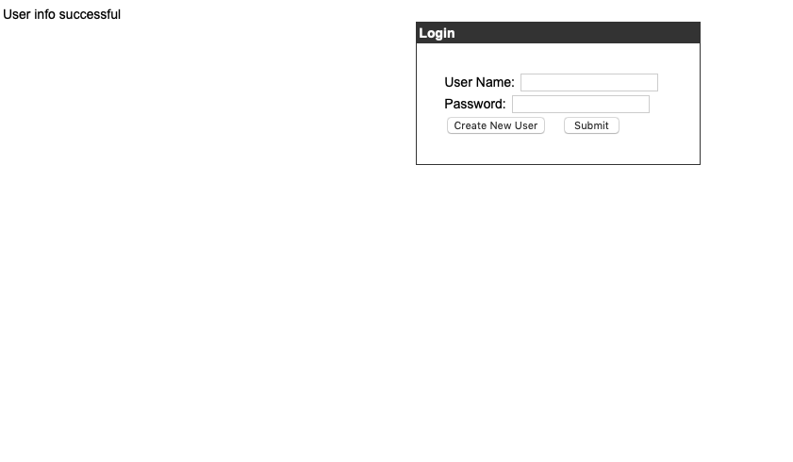
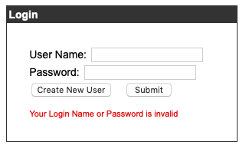
Login Users
Login Users
Create New User Page Link
Redirect to Welcome Page

Slide 4
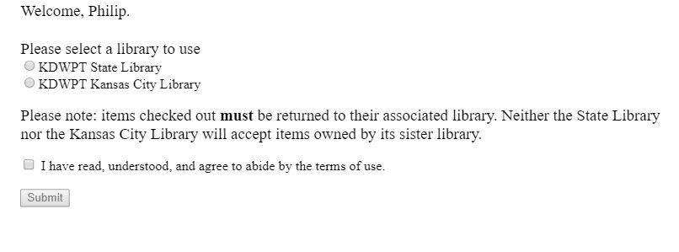
Welcome Screen
User Welcome
Select Library
Agree to terms
Admin Welcome
Under development

Slide 5
Library Catalogue (PHP)
Pull records from database
Limited to single library
Only one of each item type
Save all records selected by user to session
Check the dates before committing
First with JavaScript
Then with PHP (tricky)
Why not just Javascript?
JavaScript is client-side
Client-side can be overridden by the user

Slide 6
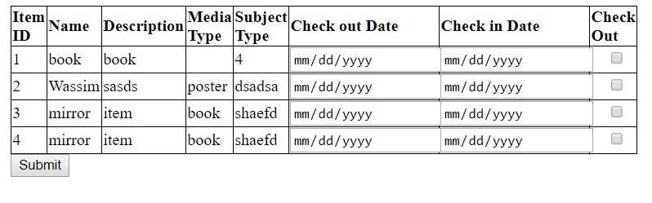
Library Catalogue
What we have
-Show All the items in the database
-Make selection of all desired items
-Choose the date for check in and check out
-Submit the information for the next page

Slide 7
Library Catalogue
what’s next?
-Table expansion to check the details of the kit
-

Slide 8
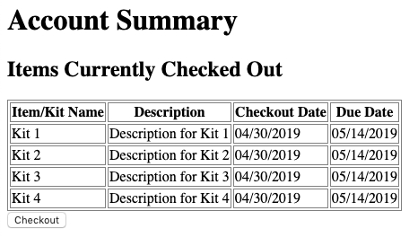
Account Summary
User checks over items they want to check out. After review:
User clicks “Back to Catalogue” button to change/delete items (still needed)
User clicks “Checkout” button to save items and automatically send email to librarian
“Checkout” button directs user to “Receipt” page

Slide 9
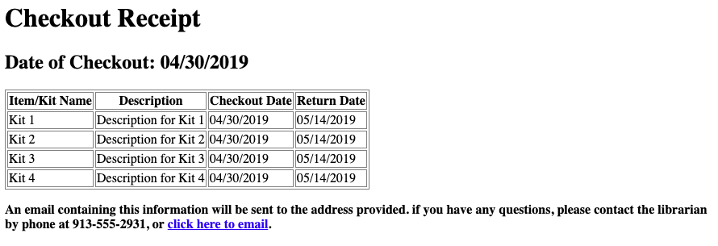
Receipt
Page shows user’s items they checked out. Page would also be sent as email to librarian.
Date of Checkout shows current date of when user checked out

